Slide 1
Pandemic Prediction Tutorial
Presenter: Boyang Fu

Slide 2
Common Models
SIR Model
Extension: SEIR model
IHME Model
Any other time series models
Notes:
Why not RNN:
We have prior knowledge
We didn’t have a lot of data (seasonal trend)

Slide 3
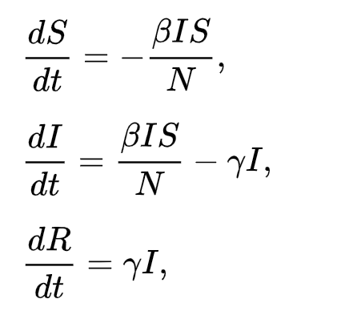
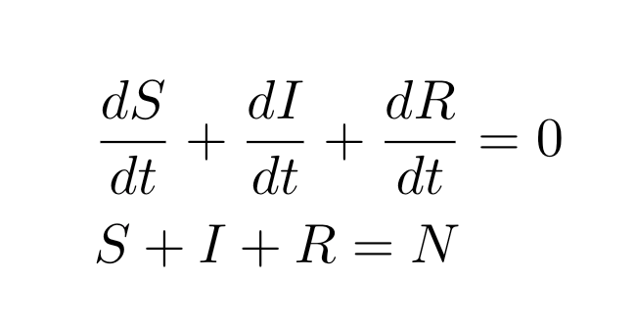


SIR model
Susceptible
$$βSI/N$$
Infectious
$$γI$$
Removed
Notes:
Sum of the individuals in each state that you took partial derivative should be 0, otherwise you need to explain carefully where does the missing population goes to

Slide 4
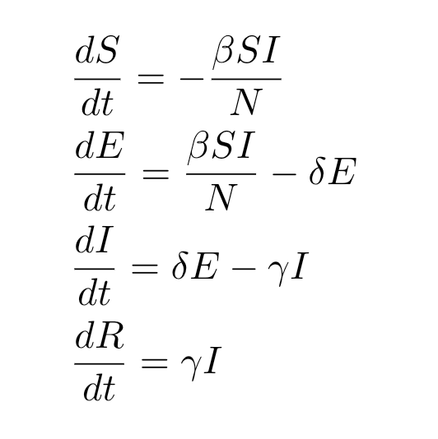
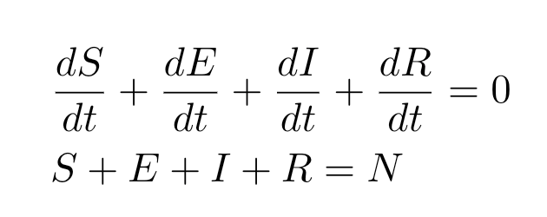



SEIR model
Susceptible
$$βSI/N$$
Exposure
$$δE$$
Infectious
$$γI$$
Remove

Slide 5
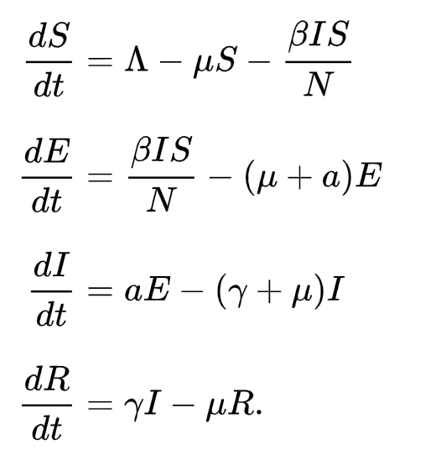
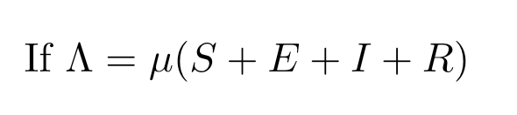
SEIR model v2
Susceptible
Exposure
Infectious
Remove
https://en.wikipedia.org/wiki/Compartmental_models_in_epidemiology
Notes:
If birth rate and death rate are equal, then constant

Slide 6
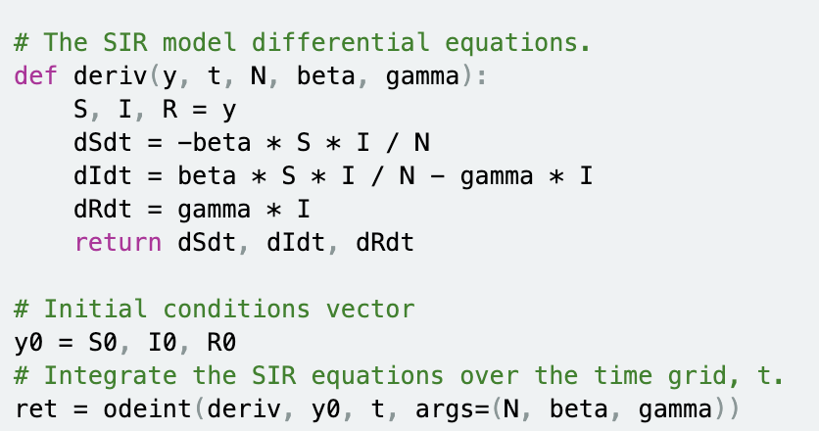
Implementation
https://scipython.com/book/chapter-8-scipy/additional-examples/the-sir-epidemic-model/

Slide 7
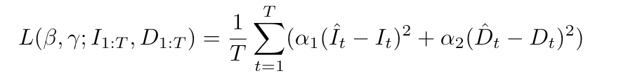
Implementation
Q: How do you choose loss function?
Ans: MSE, Log loss and so on
MSE
Log loss
Notes:
Notice that remove and death are different

Slide 8
Implementation
Q: How to learn the parameters
Ans: One option is to perform grid search, another option is use MCMC
For grid search, find the parameter combination such that they minimize the loss function
For MCMC, you can use Stan package to perform the calculation.
Notes:
Parameters should between 0 and 1

Slide 9


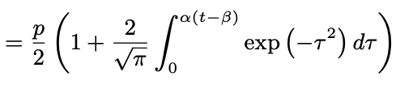
IHME
Essentially a curve fitting algorithm
α: Growth
β: Shift
p: Level Control

Slide 10
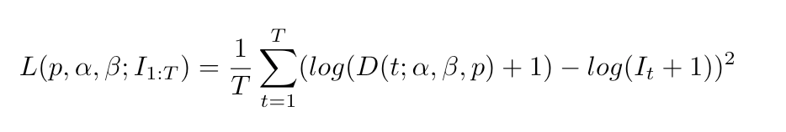
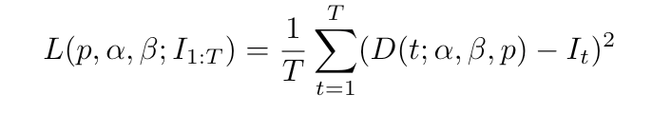
IHME
Estimated α
Estimated β
Estimated p
Model
Input
Loss Function
optimizer
MSE:
Log loss

Slide 11
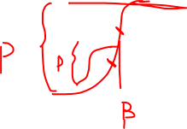
Parameter Selection
Recommendation:
Choose α between 0-0.5
In general you can assume β > 0
Choose the lower bound of p to be at least the total infectious number
Skipped some initial training point

Slide 12
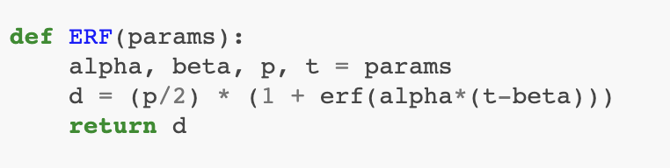
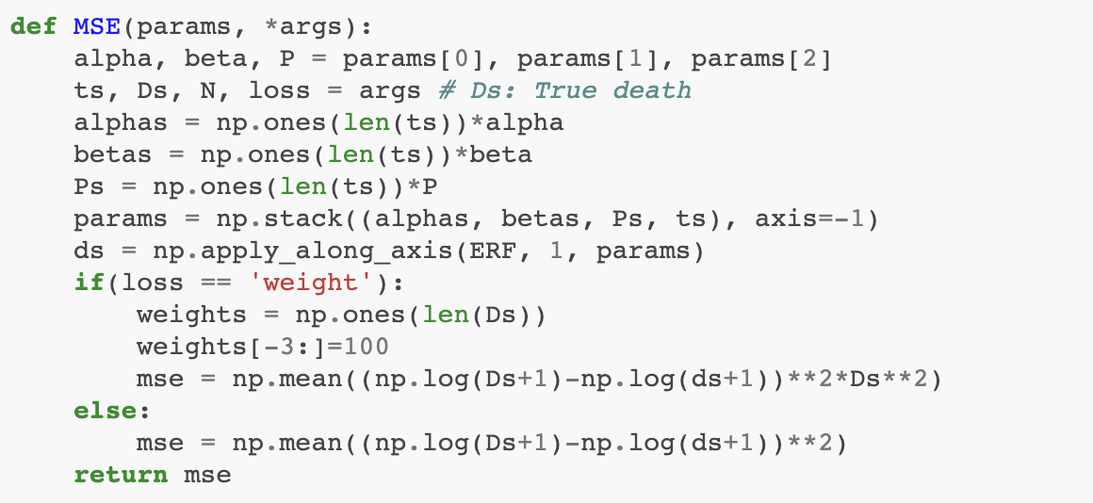
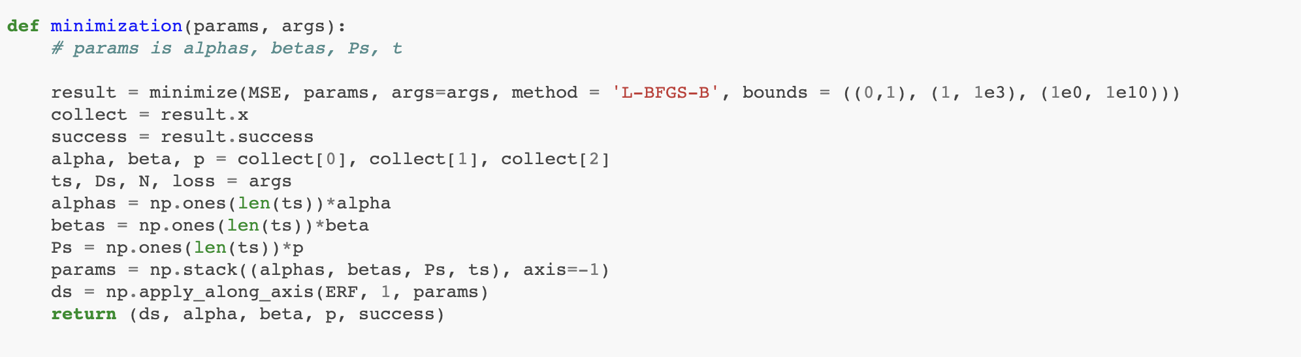
Implementation

Slide 13
Future read
https://github.com/FBoyang/BIG-Hackathon-Tutorial (Code Demo)
https://docs.scipy.org/doc/scipy/reference/tutorial/optimize.html (Python optimizer)
Stan: https://mc-stan.org/ (MCMC Tool)
ARIMA
RNN

